Slide 1
Capital Budgeting

Slide 2
Capital Budgeting
Capital Budgeting:
The firms formal process for the acquisition and investment of capital over a period of time (long run).
Budgeting of capital expenditure is an important factor in the management of a business.
It includes both raising of long term funds as well as their utilization.
Types of Capital Projects
Purchase of Plant and machinery and equipment.
Expansion of production facilities
Entering entirely new product lines
Decisions to purchase or rent production facilities, sites.
Research and Development

Slide 3
Capital Budgeting Process: Different Steps
To identify investment opportunities
Evaluating and assembling investment proposals
Decision making
Capital budget preparation and appropriations
Implementation
Review of performance

Slide 4
Capital Budgeting process: Identifying potential investment opportunities.
I. Projecting Net Cash Flows: It is the difference between cash inflows (receipts) and cash outflows (expenditures) over the life of the project.
Incremental Basis:
The cash flows from a given project should be measured by the difference between the stream of the firm’s cash flows with and without the project.
Any increase in the expenditures or reduction in the receipts of other divisions of the firm resulting from adoption of a given project must be considered
II. After-tax Basis: Net Cash flows must be estimated on an after-tax basis using the firm’s marginal tax rate.
III. Depreciation: Depreciation expenses should be added back since it is a non-cash expense that affects cash flows through its effect on taxes.

Slide 5
Derivation of Net Cash Flows
Initial Capital: 15,000 (Machinery cost: 12500; Reorganization of the activities: 2500) All values in Rs Crores
 | Estimated Cash Flows from a Project
 | Year
 | 1 | 2 | 3 | 4 | 5
Sales | 10,000 | 11,000 | 12,100 | 13,310 | 14,641
Less: 1. Variable Cost (50%) | 5,000 | 5,500 | 6,050 | 6,655 | 7,320
2. Fixed Costs | 1,500 | 1,500 | 1,500 | 1,500 | 1,500
3. Depreciation | 2,000 | 2,000 | 2,000 | 2,000 | 2,000
Profit Before Taxes | 1,500 | 2,000 | 2,550 | 3,155 | 3,820
Less: Income Tax | 600 | 800 | 1,020 | 1,262 | 1,528
Profit After Tax | 900 | 1,200 | 1,530 | 1,893 | 2,292
Plus: Depreciation | 2,000 | 2,000 | 2,000 | 2,000 | 2,000
Net cash flow | 2,900 | 3,200 | 3,530 | 3,893 | 4,292
1. Salvage Value of Equipment in year 5 |  |  |  |  | 2,500
2. Recovery of Working Capital in year 5 |  |  |  |  | 1,000
Net Cash Flow in Year 5
7,792

Slide 6
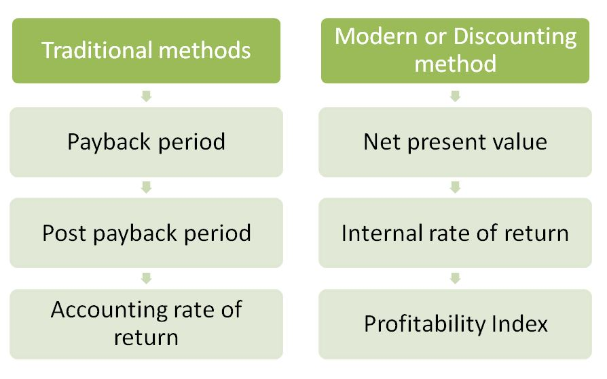
Capital Budgeting Process: Evaluation of the Project.

Slide 7
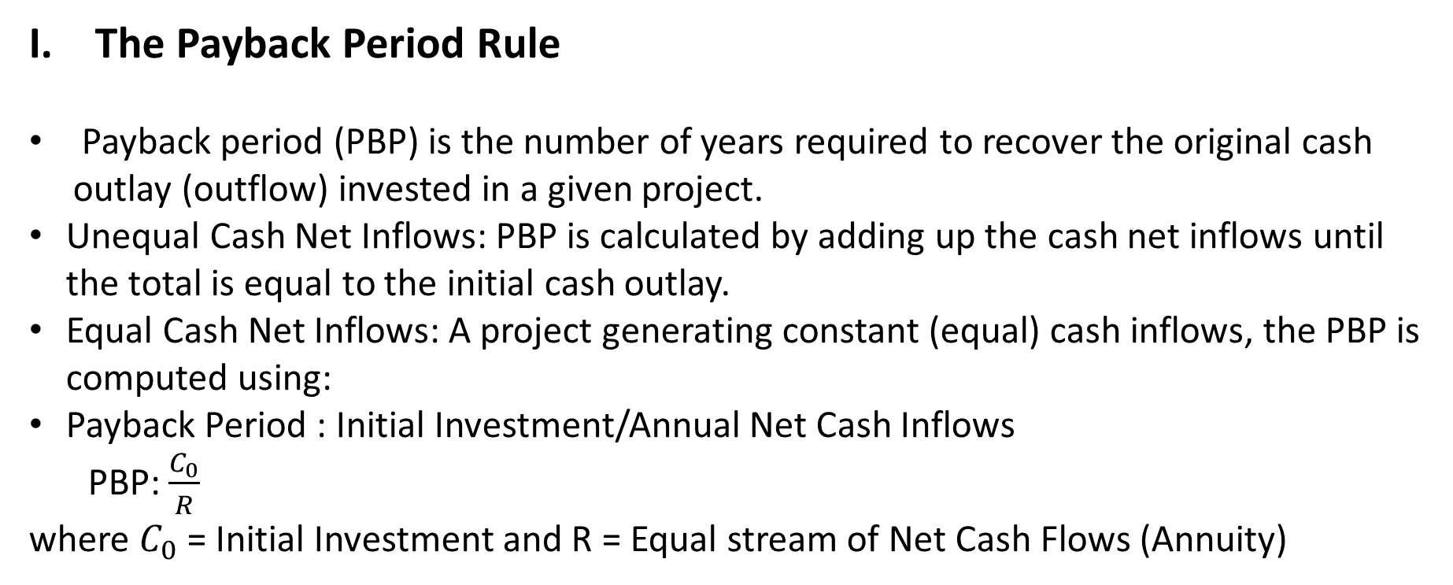
Evaluation of the project. Traditional Technique
The Payback Period Rule
Payback period (PBP) is the number of years required to recover the original cash outlay (outflow) invested in a given project.
Unequal Cash Net Inflows: PBP is calculated by adding up the cash net inflows until the total is equal to the initial cash outlay.
Equal Cash Net Inflows: A project generating constant (equal) cash inflows, the PBP is computed using:
Payback Period : Initial Investment/Annual Net Cash Inflows
PBP: $\frac{C_{0}}{R}$
where $C_{0}$ = Initial Investment and R = Equal stream of Net Cash Flows (Annuity)

Slide 8
Evaluation of the Project. Traditional Technique
Consider a project with an initial investment of INR 70,000 Cr. Cash flows are given as follows (INR in Cr):
(-70,000, 40,000, 30,000, 10,000, 5,000)
The firm receives cash flows of 40,000 and 30,000 in the first two years, which add up to the 70,000 original investment.
This means that the firm has recovered its investment within two years. In this case TWO YEARS is the payback period of the investment.
0 1 2 3 4

Slide 9
Evaluation of the Project. Traditional Technique
Decision Rule: Pay Back Period (PBP)
Ranking Criteria: Highest ranking to the project which has the shortest PBP and lowest to the project which has the highest PBP.
Accept | Reject
Accept if PBP of a project is less than the maximum payback period set by management (PBP< Maximum PBP) | Reject if PBP of a project is more than the maximum payback period set by management (PBP>Maximum PBP)

Slide 10
Evaluation of the Project. Traditional Technique
Example: Equal Cash Net Inflows
1. Assume that a project requires an outlay of INR 50,000 Cr and yields annual cash inflow of INR 12,500 Cr for 7 years. Calculate the payback period of the project.
Solution: PBP = 50,000/12,500 = 4 Years
If the estimated PBP of 4 Years is less than the maximum PBP set by the management, the project will be accepted.

Slide 11
Evaluation of the Project. Traditional Technique
Example: Equal Cash Net Inflows
2. Suppose that a project requires a cash outlay of 20,000 and generates cash inflows of 8000; 7000; 4000; and 3000 during next 4 years. What is the project’s payback period?
Solution: (-20,000, 8000,7000,4000,3000)
When we add up the first three years cash inflows, (8000+7000+4000)= 19000 of the original outlay is recovered.
In the fourth year cash inflow generated is 3000 and only 1000 of the original outlay remains to be recovered.
Assuming that the cash inflows occur evenly during the year, the time required to recover 1000 will be 4 months (3000/12=250 (250*4=1000)
PBP = 3 Years and 4 Months (3.4 Years)
Decision: Accept if 3.4 Years<Max PBP

Slide 12
Evaluation of the Project. Traditional Technique
II. Accounting Rate of Return (ARR):
It is the rate of return expected from an investment or asset.
ARR= (Average Net income/Average investment)*100
Decision Rule:
Ranking Criteria: Rank a project as number one if it has highest ARR and lowest rank would be assigned to the project with lowest ARR
Accept | Reject
Accept if ARR of a project is higher than the minimum rate established by the management (AAR>Minimum Rate). | Reject if ARR of a project is lower than the minimum rate established by the management (AAR<Minimum Rate).

Slide 13
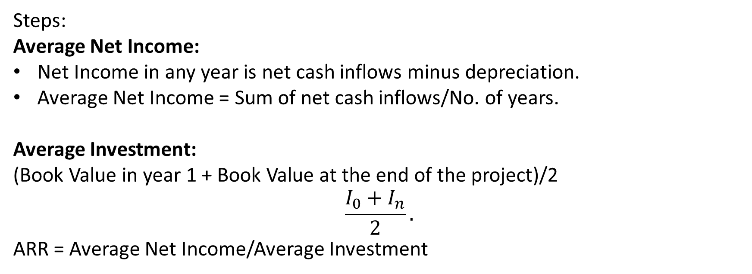
Evaluation of the Project. Traditional Technique
Steps:
Average Net Income:
Net Income in any year is net cash inflows minus depreciation.
Average Net Income = Sum of net cash inflows/No. of years.
Average Investment:
(Book Value in year 1 + Book Value at the end of the project)/2
$$\frac{I_{0}+I_{n}}{2}.$$
ARR = Average Net Income/Average Investment

Slide 14
Evaluation of the Project. Traditional Technique
Example
Consider a company that is evaluating whether to buy a store in a new mall. The purchase price is INR 700 Cr. It is estimated that the project life is 7 years and will need to be completely scrapped or rebuilt at the end of that time. The projected yearly sales and expenses are given in the next slide.

Slide 15
 | Year
 | 1 | 2 | 3 | 4 | 5 | 6 | 7
Sales | 600 | 650 | 3,00 | 250 | 100 | 90 | 40
Less: Expenses (Variable and Fixed Cost) | 300 | 200 | 150 | 150 | 50 | 50 | 30
Profit before Depreciation and Tax | 300 | 450 | 150 | 100 | 50 | 40 | 10
Depreciation | 100 | 100 | 100 | 100 | 100 | 100 | 100
Profit Before Taxes | 200 | 350 | 50 | 0 | -50 | -60 | -90
Less: Income Tax Tax rate 25% | 50 | 87.5 | 12.5 | 0 | -12.5 | -15 | -22.5
Profit After Tax | 150 | 262.5 | 37.5 | 0 | -37.5 | -45 | -67.5
Average Net Income | 52.5
Average Investment | (700+0)/2=350
ARR | (52.5/350)*100 = 15%
 | If estimated ARR of 15% if greater than Minimum Rate set by the management the project will be accepted.

Slide 16
The Average Accounting Return Rule(AAR):
Disadvantages:
Ignores the time value of money
Based on book values, not cash flows and market values

Slide 17
Evaluation of the Project. Discounted Cash Flow Technique

Slide 18
Evaluation of the Project. Discounted Cash Flow Technique
I. Net Present Value
One way of deciding whether the firm should accept or reject an investment project is to determine the Net Present Value (NPV) of the project.
NPV of a project is the difference between the present value of expected net cash inflows and the present value of cash outflows (initial cost).
Decision (NPV) Rule:
.
Accept | Reject
Accept if the NPV of a project is positive | Reject if the NPV of a project is negative

Slide 19
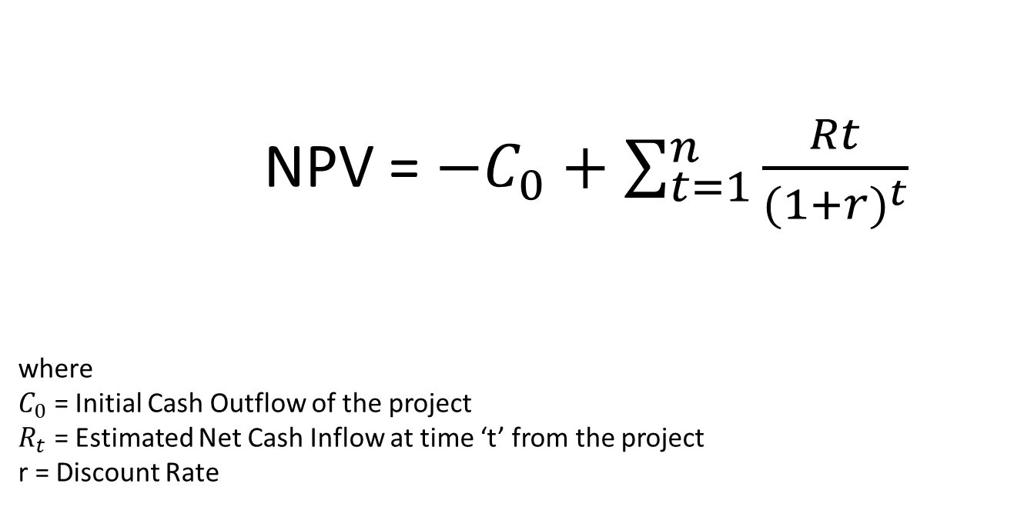
NPV = $−C_{0}+\sum_{t=1}^{n}{{\frac{Rt}{{(1+r)}^{t}}}_{}}$
where
$C_{0}$ = Initial Cash Outflow of the project
$R_{t}$ = Estimated Net Cash Inflow at time ‘t’ from the project
r = Discount Rate

Slide 20
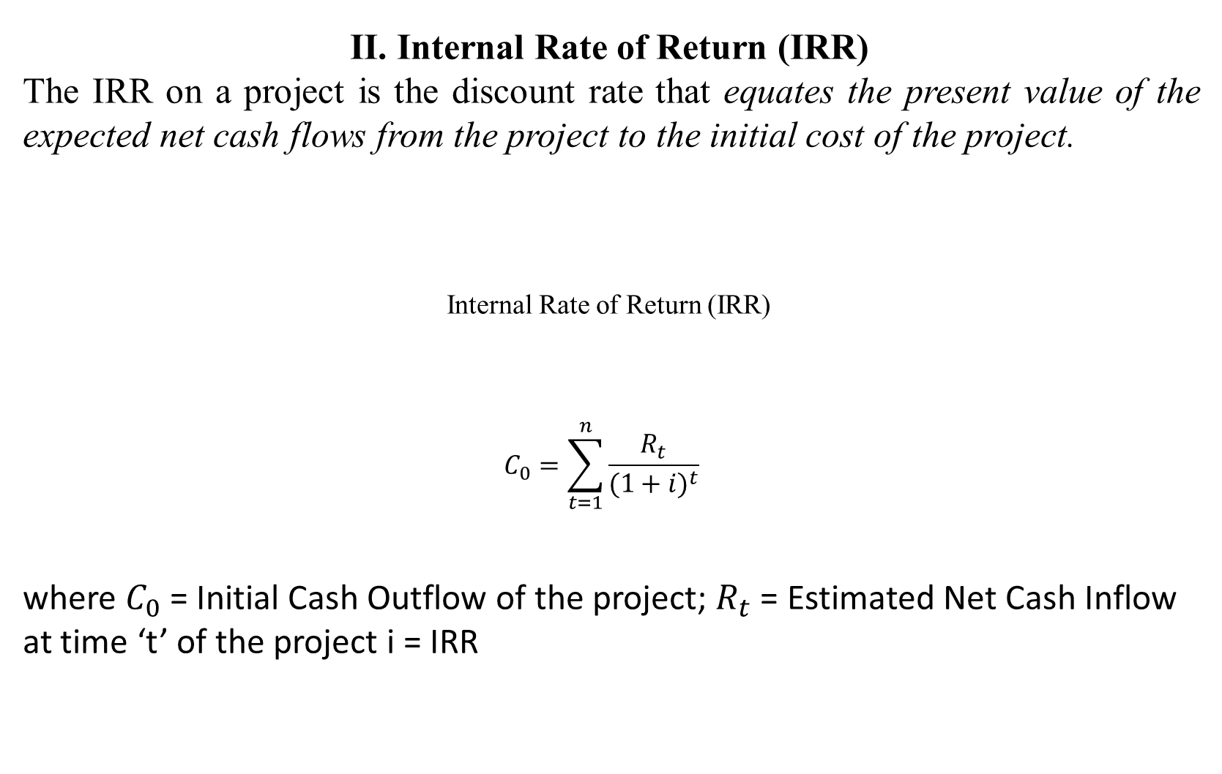
II. Internal Rate of Return (IRR)
The IRR on a project is the discount rate that equates the present value of the expected net cash flows from the project to the initial cost of the project.
Internal Rate of Return (IRR)
$$C_{0}=\sum_{t=1}^{n}{{\frac{R_{t}}{{(1+i)}^{t}}}_{}}$$
where $C_{0}$ = Initial Cash Outflow of the project; $R_{t}$ = Estimated Net Cash Inflow at time ‘t’ of the project i = IRR

Slide 21
Note: IRR does not depend on the interest rate prevailing in the capital market. It solely depends on the expected net cash flows from the project given an initial investment outlay.
Decision (IRR) Rule:
If i>r, Accept
If i < r, Reject
Accept | Reject
Accept if the IRR of a project is greater than or is equal to the discount rate. | Reject if the IRR of a project is less than the discount rate.

Slide 22
Calculation of Internal Rate of Return (IRR) by Trial and Error Method
1.Begin by using an arbitrary discount rate to calculate the PV of the net cash inflows from the project.
2.If the PV of the net cash inflows EXCEEDS the initial cost outlay of the project, INCREASE the discount rate and repeat the process.
3.If the PV of the net cash flows from the project is SMALLER than the initial cost outlay of the project, DECREASE the discount rate and repeat the process.
4.This process is continued until the rate of discount is found that equates the PV of the net cash flows from the project to the initial cost of the project.
5.The discount rate found is the IRR on the project.

Slide 23
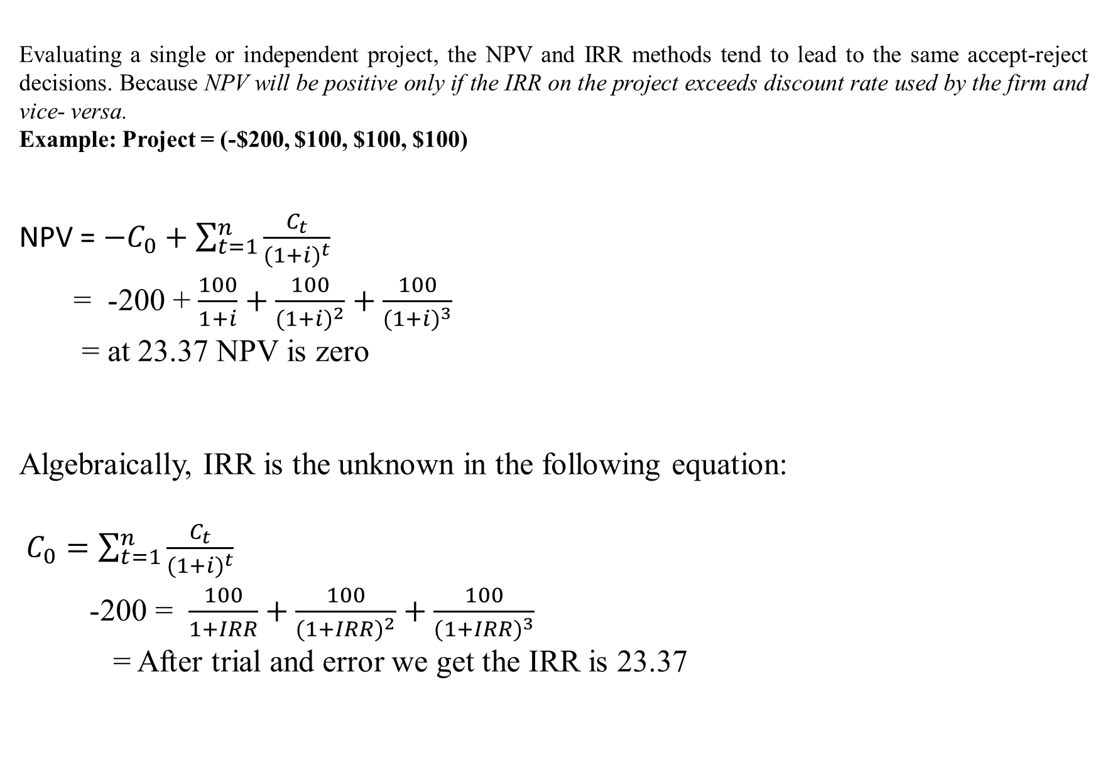
Evaluating a single or independent project, the NPV and IRR methods tend to lead to the same accept-reject decisions. Because NPV will be positive only if the IRR on the project exceeds discount rate used by the firm and vice- versa.
Example: Project = (-$200, $100, $100, $100)
NPV = $−C_{0}+\sum_{t=1}^{n}{{\frac{C_{t}}{{(1+i)}^{t}}}_{}}$
= -200 + $\frac{100}{1+i}+\frac{100}{{(1+i)}^{2}}+\frac{100}{{(1+i)}^{3}}$
= at 23.37 NPV is zero
Algebraically, IRR is the unknown in the following equation:
$C_{0}=\sum_{t=1}^{n}{{\frac{C_{t}}{{(1+i)}^{t}}}_{}}$
-200 = $\frac{100}{1+IRR}+\frac{100}{{(1+IRR)}^{2}}+\frac{100}{{(1+IRR)}^{3}}$
= After trial and error we get the IRR is 23.37

Slide 24
The Profitability Index (PI) Rule: Capital Rationing
NPV rule may lead to difficulties in the case of mutually exclusive investment projects of UNEQUAL SIZE especially where the firm may not have enough capital to fund all positive NPV projects (Capital Rationing).
A smaller project may lead to a lower NPV than an alternative larger project, but the ratio of PV of the net cash inflows to the initial cost of the project (profitability per dollar of investment) may be HIGHER on the smaller project than on the larger project.
Therefore, in cases of capital rationing (when the firm cannot undertake all the projects with positive NPV due to shortage of funds), the firm should RANK projects according to the profitability index and choose the projects with the HIGHEST Profitability Indices rather than those with the highest NPVs.

Slide 25
The Profitability Index (PI) Rule
Profitability Index (PI) =(Total Present value Net cash inflows/Present value of cash outflows).
Decision (PI) Rule
Ranking Criteria: Select alternative with highest PI in case of credit rationing.
Note: In the absence of capital rationing, the firm will undertake all the projects with a positive NPV and profitability index greater than 1.
Accept | Reject
Accept if PI of a project is greater than 1 (PI>1) | Reject if PI of a project is less than the 1 (PI<1)

Slide 26
Example: A company applies a 12% discount rate to two investment opportunities which have the following cash flows:
Initial Investment ($,m) Net Cash Inflow ($, m)
Project A 20 C1 = 70; C2 = 10
Project B 10 C1 = 15; C2 = 40
Initial Investment ($,m) PV Net Cash Inflow PI NPV
Project A
(Larger) 20 = $70/(1.12)^1+$10/(1.12)^2,
=$70.5 =$70.5/20 =3.53 50.5
Project B
(Smaller) 10 = $15/(1.12)^1 +$40/(1.12)^2
=$45.3 =$45.3/10 =4.53 35.3

Slide 27
Application of the Profitability Index: Three Situations
Independent Projects: According to the NPV rule, both projects should be accepted because NPV is positive in each case. The profitability index (PI) is greater than 1 whenever the NPV is positive. Thus, the PI decision rule is: Accept an independent project if PI > 1 and Reject it if PI < 1
2. Mutually Exclusive Projects: Let us now assume that the firm can only accept one of its two projects. NPV analysis says accept Project A because this project has the bigger NPV. Because Project B has the higher PI, the profitability index MAY lead to the wrong selection.
Reason: For mutually exclusive projects, the PI suffers from the scale problem. Project B is smaller than Project A. Because the PI is a ratio, it ignores Project A’s larger investment. Thus, PI ignores differences of scale for mutually exclusive projects.

Slide 28
3. Capital Rationing: The first two situations implicitly assumed that the firm could always attract enough capital to make any profitable investments. Now consider the case when the firm does not have enough capital to fund all positive NPV projects. This is the case of capital rationing.
Capital Rationing
Example: A company has the following three independent projects. Assume that the company has only $20 million dollars for the proposed investment. All the three projects have a life of two years--Project A, Project B and Project C. The company applies a 12% discount rate. The cash flows from the project are as follows:
Initial Investment ($,m) Net Cash Inflow ($, m)
Project A 20 C1 = 70; C2 = 10
Project B 10 C1 = 15; C2 = 40
Project C 10 C1 = -5; C2 = 60

Slide 29
Initial Investment PV Net Cash Inflow PI NPV
($, m)
Project A
(Larger) 20 = $70/(1.12)1+$10/(1.12)2 =$70.5 =$70.5/20 =3.53 50.5
Project B
(Smaller) 10 = $15/(1.12)1 +$40/(1.12)2 =$45.3 =$45.3/10 =4.53 35.3
Project C
(Smaller) 10 = $-5/(1.12)1 +$60/(1.12)2 =$43.4 =$43.4/10 =4.34 33.4
Important Observations:
1. The PI of project B (4.53) is greater than PI of project C (4.34) and A (3.53).
2. The NPV of project A ($50.3 million) is greater than the NPV of project B ($35.3 million) and C ($33.4 million).

Slide 30
3. Since project A has an initial investment of $20 million, the firm cannot select both project A and another one. However, projects B and C both can be selected which have an initial investment of $10 million each.
Decision: Individually, projects B and C have lower NPVs than project A. However, when the NPVs of projects B and C are added together, the sum is higher than the NPV of project A. Thus, the projects B and C should be accepted.
Important: Jointly, projects B and C increase the value of the firm, BUT they would not be undertaken if the firm followed the NPV rule and could invest only $20 million.
NPV vs PI In the case of (capital rationing) limited funds, one cannot rank projects according to their NPVs. Instead, one should rank them according to the ratio of present value to initial investment (PI Index). This is the PI rule. Both project B and project C have higher PI ratios than does project A. Thus, they should be ranked ahead of project A when capital is rationed.

Slide 31
The Discounted Payback Period Rule
Payback is the number of years required to recover the original cash outlay invested in a project. Under this approach first the net cash inflows are discounted to calculate their PV and then payback period is determined.
Decision (DPBP) Rule:
Ranking Criteria: Highest ranking to the project which has the shortest DPBP and lowest ranking to the project with has the highest DPBP
Accept | Reject
Accept if DPBP of a project is less than the maximum payback period set by management (DPBP < Maximum PBP ) | Reject if DPBP of a project is more than the maximum payback period set by management (DPBP>Maximum PBP)

Slide 32
Example
1.Projects P and Q involve the same outlay of $4000 each. The risk adjusted cost of capital is 10%. The cash flows from Project P and Q are given below:
C0 C1 C2 C3 C4
Project P -4000 3000 1000 1000 1000
Project Q -4000 0 4000 1000 2000
Example
Present Value of cash inflows from Project P using PVIF
Initial Investment = $4000
Year Cash flows ($)
1 3000
2 1000
3 1000
4 1000

Slide 33
Present Value of Cash Inflows Project P
Year end | Cash flows ($) | Present value factor (2) × (3) | Present value
1 | 3000 | 0.909 | 2727
2 | 1000 | 0.826 | 826
3 | 1000 | 0.751 | 751
4 | 1000 | 0.683 | 683
Simple PBP = 2 Years ($3000+$1000)
DPBP = 2.7 Years ($2727+$826+$447) ($751/12 = $62.58)

Slide 34
Present Value of cash inflows from Project Q using PVIF
Initial Investment = $4000
Year Cash flows ($)
1 0
2 4000
3 1000
4 2000
Year end | Cash flows ($) | Present value factor (2) × (3) | Present value
1 | 0 | 0.909 | 0
2 | 4000 | 0.826 | 3304
3 | 1000 | 0.751 | 751
4 | 2000 | 0.683 | 1366
Simple PBP = 2 Years (0+$4000)
DPBP = 2.11 Years (0+$3304+$751) ($751/12 = $62.58)

Slide 35
Ranking:
Simple PBP DPBP
Project P 2 Years 2.7 Years
Project Q 2 Years 2.11 Years
PBP: Pay Back Period
DPBP: Discounted Payback Period
If the estimated DPBP of 2.7 Years is less than the Maximum DPBP set by the management, the project P will be accepted.
These are the main ways of Evaluating the Capital budgeting processes and taking decision about any project.

Slide 36
Thank You

